Slide 1
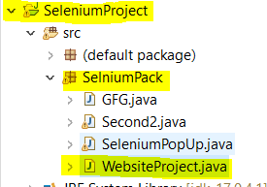
AMAZON WEBSITE AUTOMATED TEST SCRIPT TO TEST THE CRITICAL FUNCTIONALITIES
TOPIC -
Selenium WebDriver is used to test the basic functionalities of an E-Commerce Website having using java as programming language.
INTRODUCTION-
In this project website AMAZON which is very famous e-commerce website for all things which we need in daily life.
Why we choose this website for testing?
Amazon is one of the most common and useful websites which have several functionalities to check from small to critical functionalities we can check here.
It's help us for full-fledged testing, Amazon.com test multiple things at the same time.
Why we used Selenium WebDriver in this project, following are the advantage-
Selenium Webdriver comes without any cost and we do not need to buy a license for its usage. We can just download and start using it for automating the test cases.
Selenium Webdriver can be used to test an application in multiple browsers like Chrome, Firefox, Safari, IE, and so on.
Selenium Webdriver can support multiple languages like Java, Python, JavaScript, C# and so on.
Selenium Webdriver can be used to stimulate human-like actions like drag and drop, keypress, click and hold, and so on. This is done with the help of the Actions class.
Steps followed to do the Functionality Testing via automated scripts are as follows -
1.Create a Selenium Project using Eclipse IDE

Slide 2
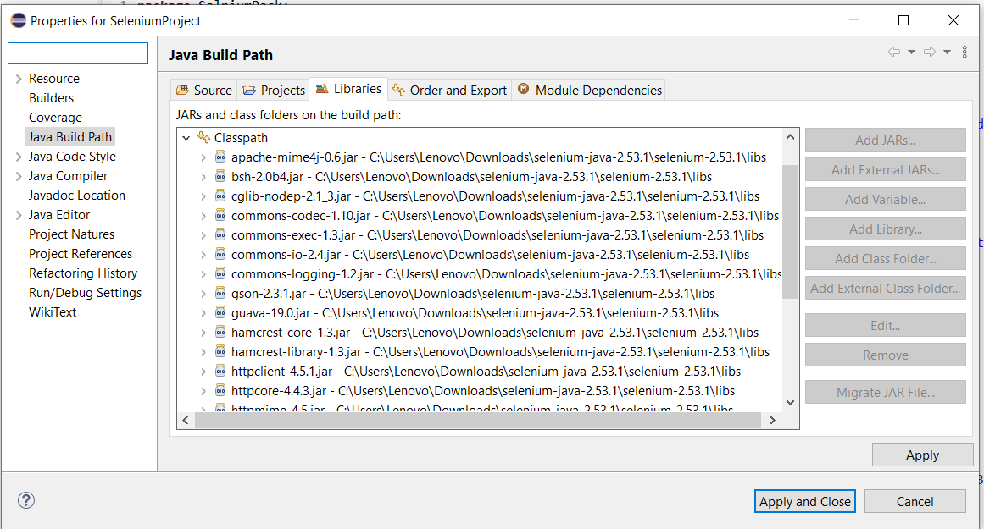

2.Add referenced JARS Files which will be used in this project to test the Website.
Why Jars Needed -
JARS -
3.Import all the packages needed in this project
4.Under main method property has been set, and to launch the Chrome Browser.
5. driver.get() --> methods to fetch a web page.

Slide 3
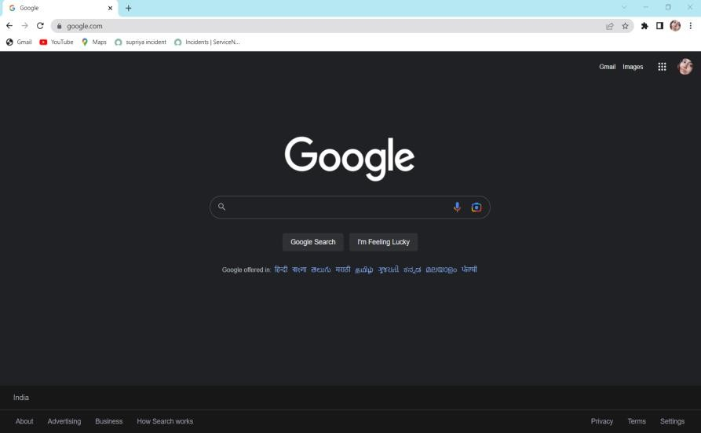
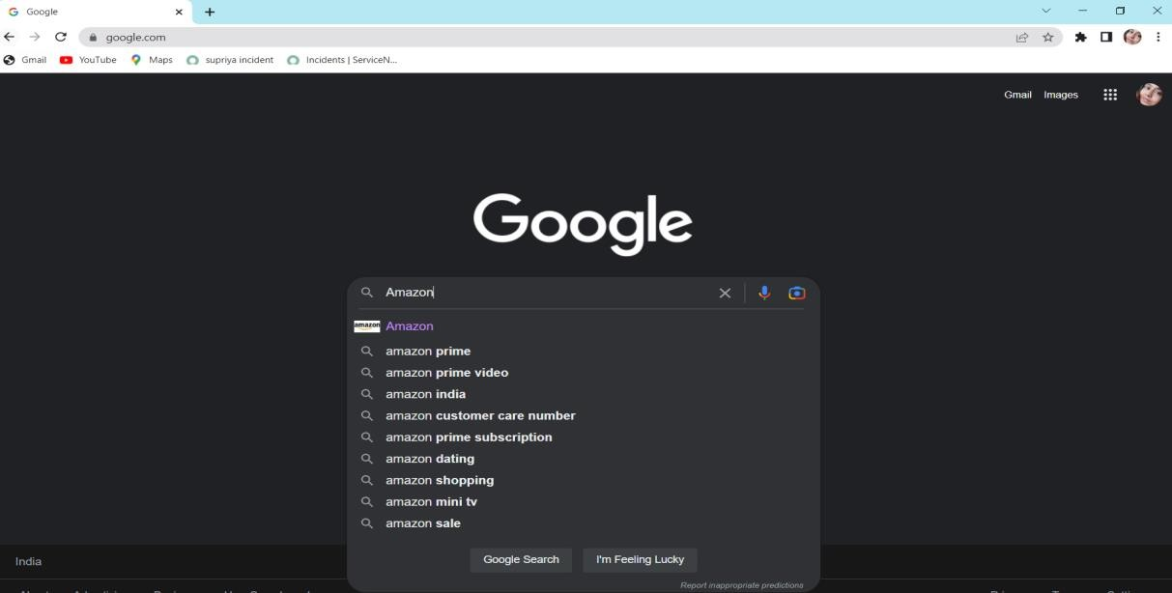
6. driver.manage().window().maximize(); --> Method used to maximize the window
7. driver.findElement(By.name("q")).sendKeys("Amazon"); --> method Locating forms and sending
user inputs

Slide 4
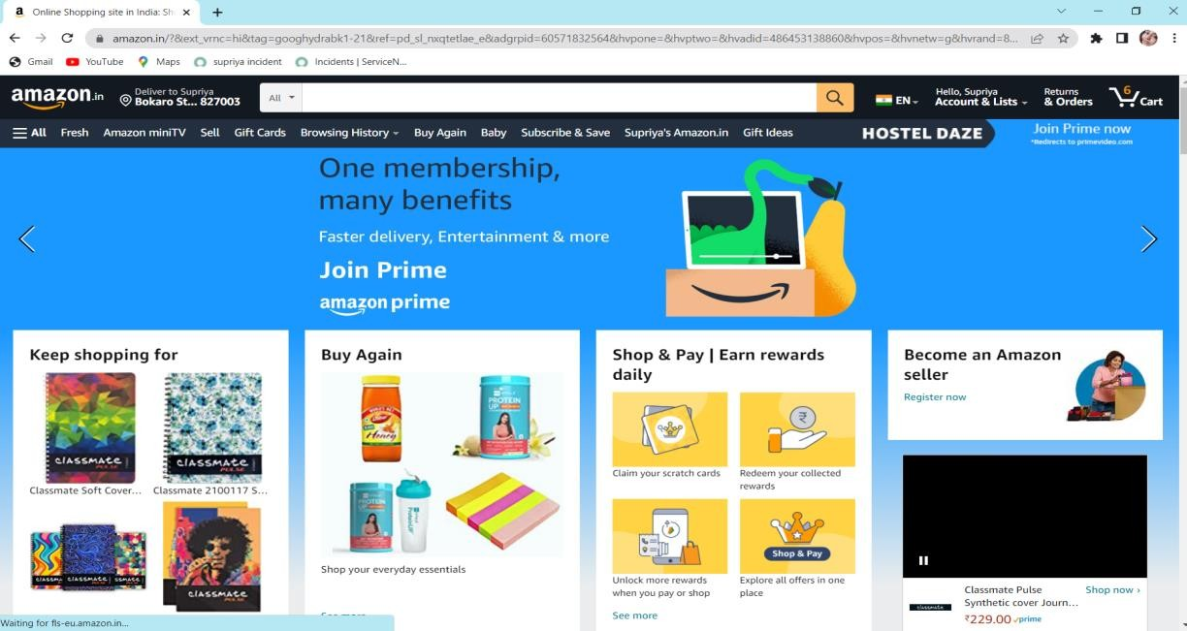
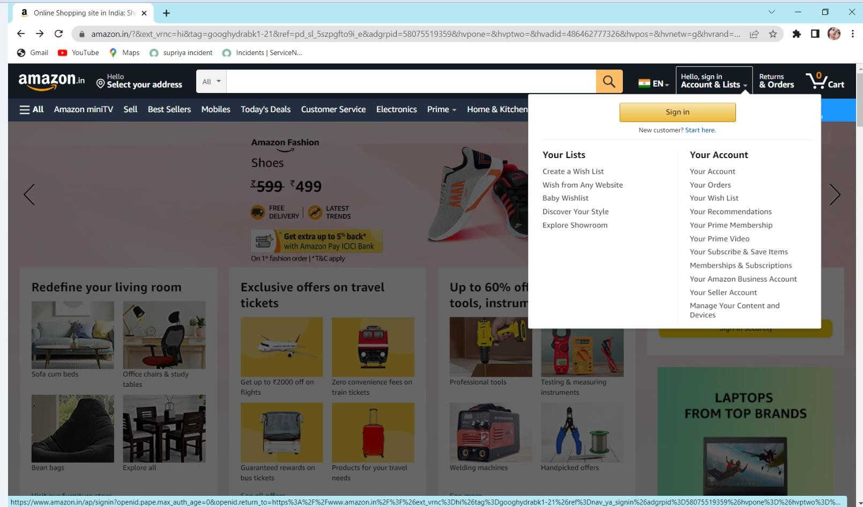
8. Thread.sleep(1000); --> It always halts the execution of the current thread, here we use 1000 mls.
9. navigate().to ---> methods to fetch a web page, here it fetches first amazon homepage and then redirect to sign in page.
10. findElement(By.id()); --->
method Locating forms with help of id
WebElement ---> predefined Interface in selenium

Slide 5

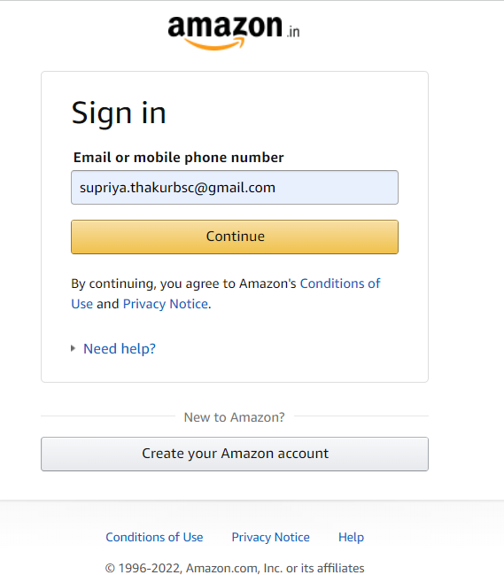
message --> reference where the value store.
sendKeys() --> Sending user inputs like we are entering a valid and registered email Id and then submit the response.
11. findElement(By.id()); --->
method Locating forms with help of id for password
WebElement ---> predefined Interface in selenium
password --> reference where the value store.
sendKeys() --> Sending user inputs like we are entering a valid password and then submit the response.
click() --> This method can be used to execute a click on an element as if the user manually clicked on it.

Slide 6
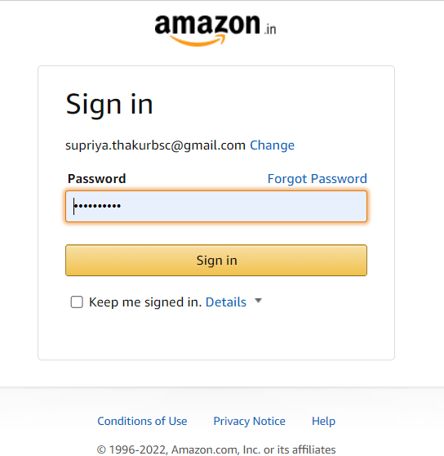
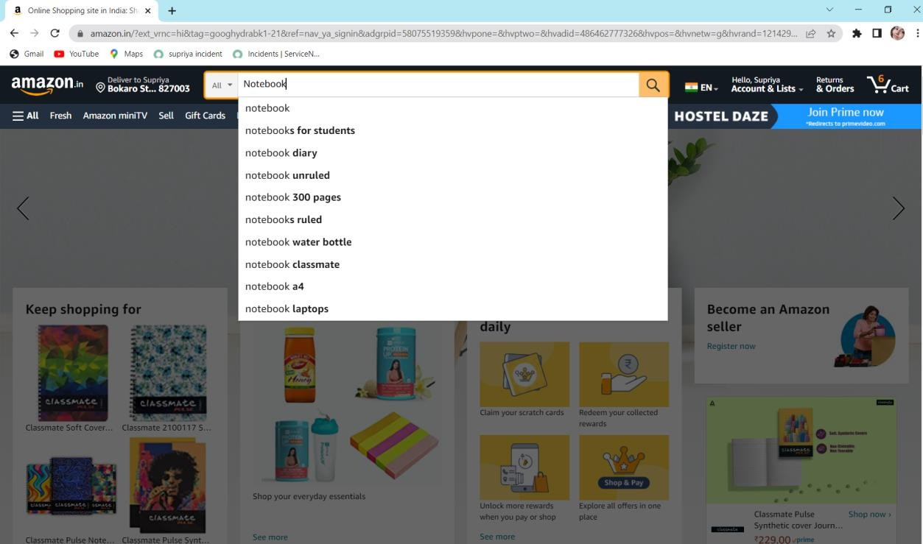
12. WebElement search=driver.findElement(By.xpath("//input[@id='twotabsearchtextbox']")); search.sendKeys("Notebook"); driver.findElement(By.xpath("//header/div[@id='navbar']/div[@id='nav- belt']/div[2]/div[1]/form[1]/div[3]/div[1]")).click();
By.xpath--> method is used to identify an element which matches with the xpath locator passed as a parameter to this method

Slide 7
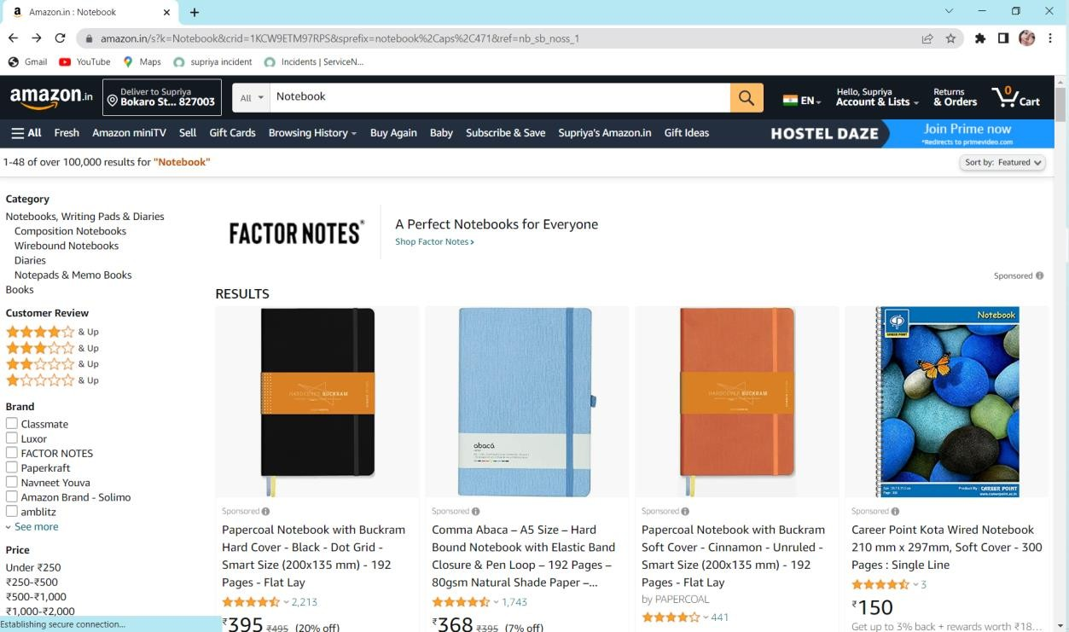
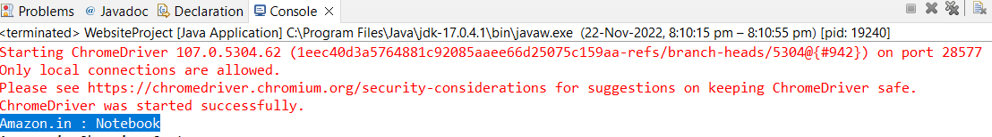
13.Get the title of the current page and print it in console.
String pageTitle = driver.getTitle(); System.out.println(pageTitle);
14. JavascriptExecutor js = (JavascriptExecutor)driver;
WebElement notebook = driver.findElement(By.linkText("Classmate Soft Cover
6 Subject Spiral Binding Notebook, Single Line, 300 Pages")); js.executeScript("arguments[0].scrollIntoView();", notebook); notebook.click();
JavascriptExecutor --> A Scroll is a JavaScript method. The JavaScriptExecutor provides an interface that enables QAs to run JavaScript methods from Selenium scripts.
scrollIntoView() -->The method is used to scroll to a location in the browser window.
linkText() --> used to identify the hyperlinks on a web page

Slide 8
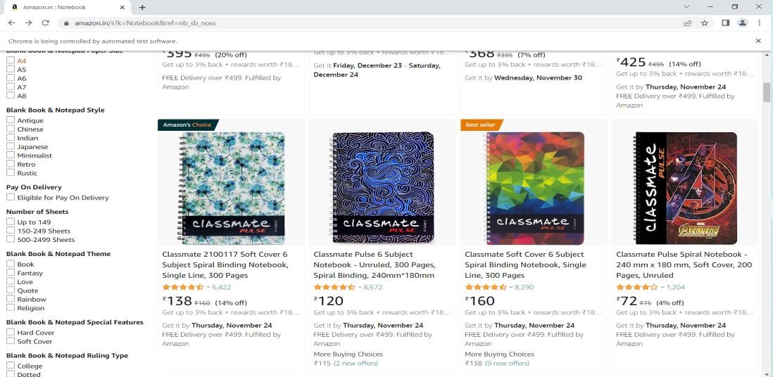
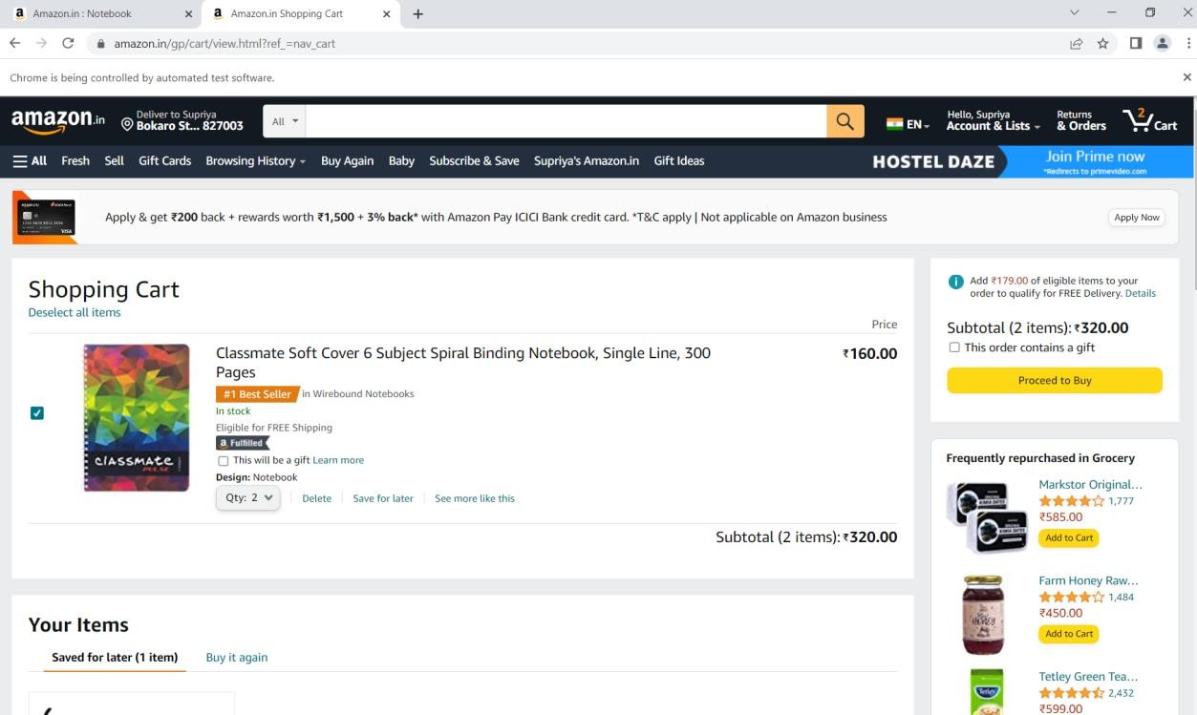
15. //add to cart and visit to card
driver.findElement(By.xpath("//a[@id='nav-cart']")).click();
16. Get the current page title--> String pageTitle2 = driver.getTitle(); System.out.println(pageTitle2);
17.
dropdown to select the quantity of the item
WebElement dropdown = driver.findElement(By.name("quantity")); Select testdropdown = new Select(dropdown);

Slide 9
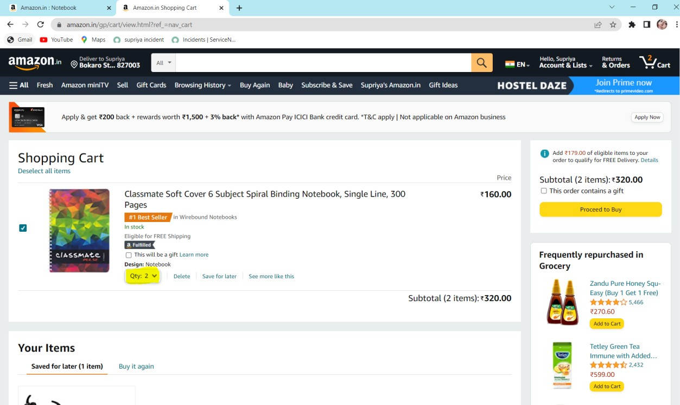

testdropdown.selectByIndex(5);
18. Checkbox selected -->
driver.findElement(By.id("sc-buy-box-gift-checkbox")).click();

Slide 10
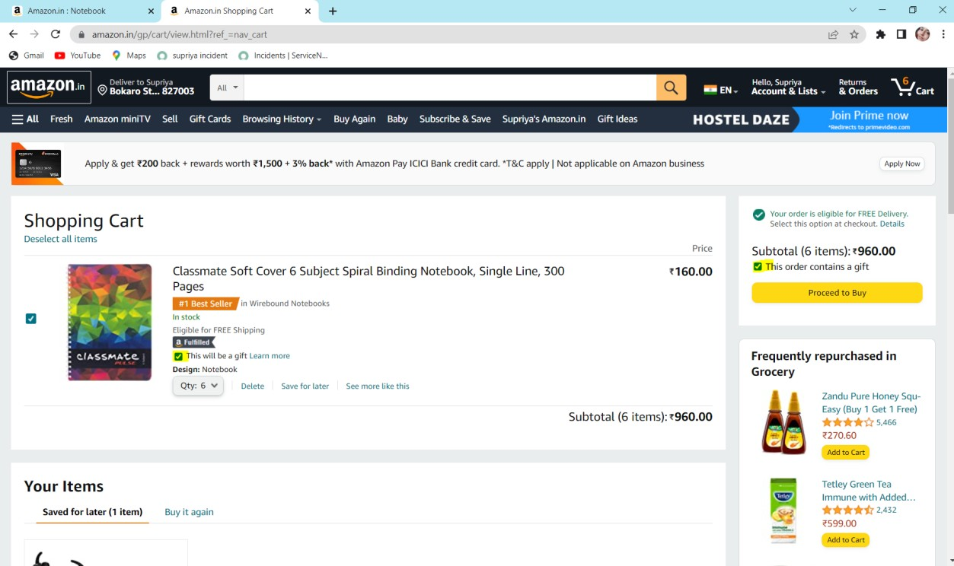
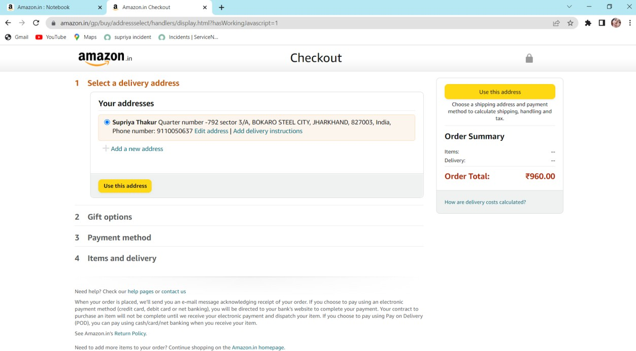
19. proceed to buy-->
driver.findElement(By.id("desktop-ptc-button-celWidget")).click();
20. fill the form
WebElement dropdown2 =driver.findElement(By.name("address-ui-widgets-countryCode")); Select testdropdown2 = new Select(dropdown2);
testdropdown2.selectByIndex(5);
driver.findElement(By.id("address-ui-widgets-enterAddressFullName")).sendKeys("Parul");

Slide 11
driver.findElement(By.id("address-ui-widgets- enterAddressPhoneNumber")).sendKeys("923456677878"); driver.findElement(By.id("address-ui-widgets-DetectLocationButton-announce")).click(); driver.findElement(By.id("address-ui-widgets-form-submit-button")).click();
Difficulties Faced while testing these functionalities are as below-
Scrolling downstream and selecting particular images was challenging here.
Switch to different window and to check other functionalities like add to cart and buy now in this web page.
How we overcome with difficulties in this project -
We manually tried to located those elements with IDs and relative xpath able to locate and pages are accessible now.
Results -
1. Able to visit amazon webpage. 2.Successfull login with ID and password.
Use of search with valid product name, shows expected results.
use button add cart and show added product in cart shows expected results.
Checkbox and dropdown working as expected.
Additional methods also has been checked in this project like and yet to be implemented -
//driver.navigate().refresh();
//Thread.sleep(1000);
//driver.navigate().back();
//Thread.sleep(1000);
//driver.navigate().forward();
//js.executeScript("scrollBy(0, 4500)");
//Thread.sleep(2000);
getWindowHandles()- used to handle multiple windows 3.partiallinkText()
Test Case prepared based on some functionalities - https://d.docs.live.net/d884c19fe08aefbc/Desktop/TEST_CASE_DATA_AMAZON_PROJECT.xlsx

